Slide 1

بسم الله الرحمن الرحيم

Slide 2

Renal Replacement Therapies
presented by Mohamed Hamdi Elbriery
Demonstrator at Clinical toxicology and forensic medicine department

Slide 3
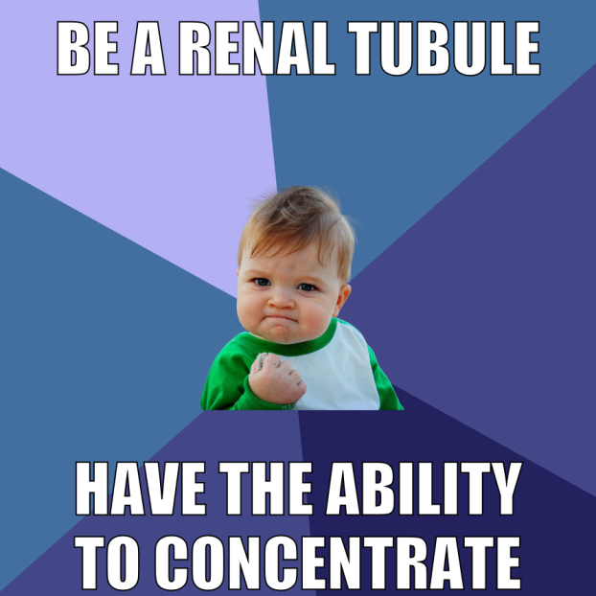
Objectives
Review renal function and dysfunction
Renal replacement therapy (RRT) options
Technical aspects of RRT
RRT access types
Complications associated with RRT
Indications for RRT

Slide 4
Normal Renal Functions
Maintenance of body fluid composition
volume, osmolality, electrolyte, acid-base regulations
Excretion of metabolic end products and foreign substances (e.g. medications)
Neurohormonal
renin, angiotensin, erythropoietin, 1,25-OH vitamin D

Slide 5
The Dysfunctional Kidney
Abnormal body fluid composition
Fluid overload, sodium retention, hyper K+, hypophosphatemia, acidosis
Impaired excretion of substances
Azotemia, uremia, intoxication or overdose
Neurohormonal deficiencies or excess
Hypertension, anemia, vitamin D deficiency, hyperparathyroidism

Slide 6
Renal Replacement Therapy
Therapy which replaces some or most of the functions of the normal kidney
Water handling: fluid removal
Solute clearance: electrolytes, acids, metabolic byproducts, foreign substances
Water handling = ultrafiltration
Solute clearance = dialysis
Utilizes semipermeable membrane

Slide 7
Types of RRT
Intermittent Hemodialysis (IHD)
Continuous Dialysis (CRRT)
Continuous veno-venous hemo-dialysis/ -filtration/ -diafiltration (CVVHD, CVVHF, CVVHDF)
Sustained low-efficiency daily dialysis (SLEDD)
Peritoneal dialysis (PD)
Renal Transplant

Slide 8
Principles of Dialysis: Diffusion
Compartment #1 Compartment #2
Hydrostatic pressure (P_{h}) = Hydrostatic pressure (P_{h})
Concentration [x] > Concentration [x]

Slide 9
Principles of Dialysis: Convection
Compartment #1 Compartment #2
solvent drag
P_{h} > P_{h}
[x] ≈ [x]

Slide 10
Diffusion With Convection
Compartment #1 Compartment #2
P_{h} > P_{h}
[x] > [x]

Slide 11
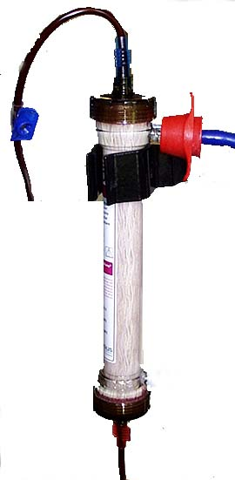
Dialysis Setup
Blood (Q_{B}) Dialysate (Q_{D})
From patient
To drain
Inflow
To patient
Hemodialyzer

Slide 12
Diffusion: Hemodialysis
Blood (Q_{B}) Dialysate (Q_{D})
From patient
To drain
Urea
100 mg/dL
20 mg/dL
Urea
80 mg/dL
0 mg/dL
Inflow
To patient
Hemodialyzer

Slide 13
Convection: Hemofiltration
From patient
To drain
P_{h}=+50mmHg
Urea
100 mg/dL
P_{h}= -250mmHg
Urea
100 mg/dL
Ultrafiltrate
To patient
Hemodialyzer

Slide 14
Diffusion & Convection: Hemodiafiltration
Blood (Q_{B}) Dialysate (Q_{D})
From patient
To drain
Ultrafiltrate & Dialysate
Dialysate Inflow
To patient
Hemodialyzer

Slide 15
Peritoneal Dialysis
Blood Dialysate
Intra-abdominal cavity
Peritoneal capillary beds
Ultrafiltrate* & Dialysate
*ultrafiltration through osmotic rather than hydrostatic gradient
Peritoneal membrane

Slide 16
Technical Considerations
 | IHD | CRRT | PD
Blood flow (ml/min) | 300-450 | 80-150 | NA
Dialysate flow (ml/min) | 500-800 | 1000-1500 | NA
Duration (hours) | 3-4 | 12-24 | 8-24
Membrane | Hemodialyzer | Hemodialyzer | Peritoneal

Slide 17
Factors Affecting Dialysis Efficiency
How Much?
size of the semi-permeable membrane
How Long?
duration of dialysis
How Fast?
rate of dialysate replenishment

Slide 18
Different Settings for Dialysis
Inpatient/Acute:
IHD: daily or 3x/week, temporary or long-term
CRRT: daily, temporary
PD: daily, usually longer-term
Outpatient/Chronic:
IHD: 3x/week, daily nocturnal, in-center or home
PD: daily, manual exchanges or night time cycler with/without day exchange(s), home

Slide 19
Complications of RRT
Dialysis process related
Water/volume mediated: hypovolemia
Solute mediated: electrolyte shifts, alkalemia
Anticoagulation-related: bleeding, low platelets
AV access or catheter related
Non-function
Infections
Steal syndrome (AVF > AVG)
High output heart failure (AVF)
Central venous stenosis (catheters)

Slide 20
Complications of RRT
Dialysis process related
Water/volume mediated: hypovolemia
Solute mediated: electrolyte shifts, alkalemia
Anticoagulation-related: bleeding, low platelets
AV access or catheter related
Non-function
Infections
Steal syndrome (AVF > AVG)
High output heart failure (AVF)
Central venous stenosis (catheters)

Slide 21
Volume & Hypotension
Ultrafiltration rate > plasma refilling rate:
Intravascular volume
ICV 28L
Volume removal* | 8L
Time of Tx | 4hrs
Fluid removal rate | 2L/hr
Extravascular Volume
=
=
=
ICV 28 L
3 L
+
2 L*
ultrafiltrate
2 L/hr during 4 hr treatment
11 L + 6 L*
Plasma refilling 1.5 L/hr

Slide 22
Hypotension & Renal Function
Residual renal function (ml/min/.73m²) in different dialysis modalities
Months | 0 | 6 | 12 | 24
CAPD | 7.4 | 6.8 | 6.0 | 3.1
Hemodialysis:
- Cellulosic, low-flux | 7.4 | 3.8 | 3.0 | 1.2
- Polysulfone, high-flux | 7.6 | 5.7 | 4.5 | 2.3
Adapted from Lang et al, Perit Dial Int 2001, (21) 1

Slide 23
Solute Shifts
Typical dialysate composition (mEq/l)
Na⁺ 140
Cl⁻ 100
K⁺ 0-4
Ca⁺⁺ 2.5
Mg⁺⁺ 0.75
HCO₃⁻ 35
Dextrose (mg/dL) 200

Slide 24
Solute Shifts Affect CNS
CNS cell Pre-HD
CNS cell post-HD
ICV
Osmo
330
ECV
Osmo
330
IVV
Osmo
330
ICV
Osmo
328
ECV
Osmo
310
IVV
Osmo
300
Plasma: Na 140, glucose 200, BUN 110
Plasma: Na 140, glucose 200, BUN 25

Slide 25
Dialysis Dysequilibrium Syndrome
Nausea
Headache
Anorexia
Dizziness
Muscle cramps
Clinical Manifestations:
Coma
Asterixis
Blurred vision
Restlessness
Disorientation
IHD can also increase intracranial pressure

Slide 26
Complications of RRT
Dialysis process related
Water/volume mediated: hypovolemia
Solute mediated: electrolyte shifts, alkalemia
Anticoagulation-related: bleeding, low platelets
AV access or catheter related
Non-function
Infections
Steal syndrome (AVF > AVG)
High output heart failure (AVF)
Central venous stenosis (catheters)

Slide 27
Dialysis Access Options
Arterio-Venous (AV) access
fistula
graft
Catheter
tunneled, non-tunneled, central venous
peritoneal

Slide 28
Dialysis Access: AV fistula
Arterio-venous anastomosis of native vessels
First choice for vascular access
Common types (in order of preference): radiocephalic, brachiocephalic, brachiobasilic (transposed)
First use: 8+ weeks post placement

Slide 29
Dialysis Access: AV Graft
Synthetic graft conduit between artery and vein; Polytetrafluoroethylene (PTFE)
Foreign body, potential infection source
Locations: radiocephalic (straight), brachiocephalic (loop), brachioaxillary (straight), axillary-to-axillary (loop), leg, chest
First use: 2-3 weeks; some within 24 hrs

Slide 30
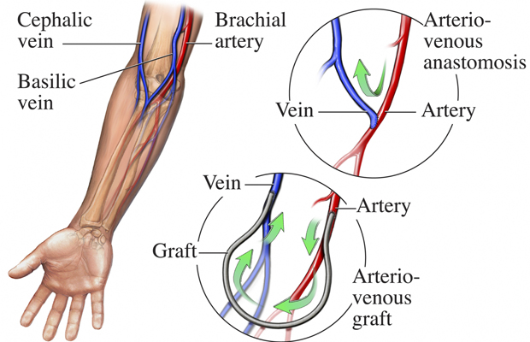
Anatomy of AV Access
Images courtesy of Dialysis Technician Training Hub

Slide 31
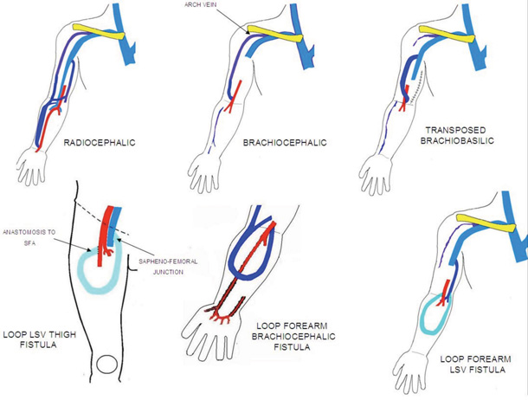
AV Fistula Types
Images courtesy of minnisjournals.com.au

Slide 32
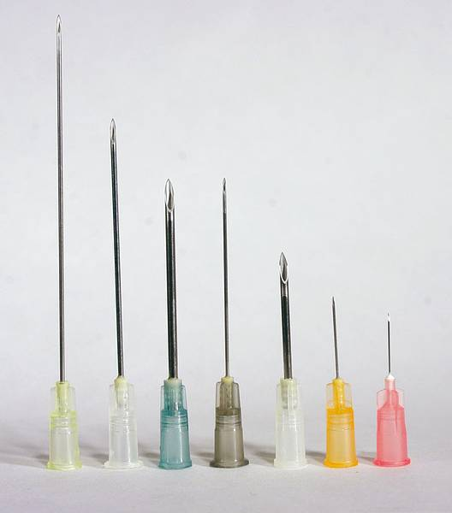
Dialysis Needle Sizes
15G 16G
Images courtesy of www.dispomed.de

Slide 33
Fistula or Graft?
Fistula |  | Graft
Pro | Con | Pro | Con
Best overall performance Less chance of infection Greater access longevity Predictable performance Increased blood flow | Visible on forearm Longer maturation period Can have very high blood flows Failure to mature | Readily implanted Predictable performance Can be used sooner than AV fistula | Increased potential for clotting Increased potential for infection Shorter access longevity than AV fistula
Adapted from AAKP “Understanding Your Hemodialysis Access Options”

Slide 34
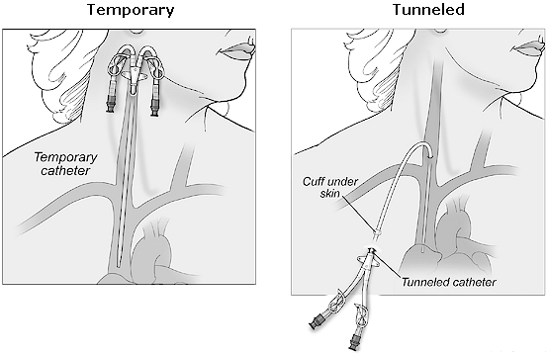
Dialysis Access: CVC
Images courtesy of Sutter Health CPMC

Slide 35
Central Venous Catheters
Pro | Con
Immediate use Easy to insert Local anesthesia Easy removal and replacement Avoids needle sticks | Not an ideal permanent access High infection rates Lower blood flow limits Central venous stenosis Swimming and bathing not recommended; showering is difficult
Adapted from AAKP “Understanding Your Hemodialysis Access Options”

Slide 36
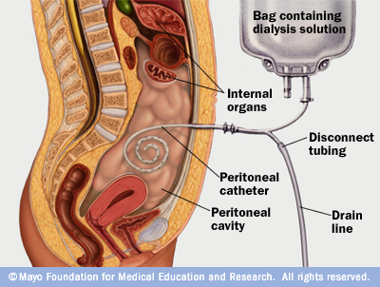
Dialysis Access: peritoneal catheter
Image courtesy of Mayo Foundation for Medical Education and Research

Slide 37
Complications of RRT
Dialysis process related
Water/volume mediated: hypovolemia
Solute mediated: electrolyte shifts, alkalemia
Anticoagulation-related: bleeding, low platelets
AV access or catheter related
Non-function
Infections
Steal syndrome (AVF > AVG)
High output heart failure (AVF)
Central venous stenosis (catheters)

Slide 38
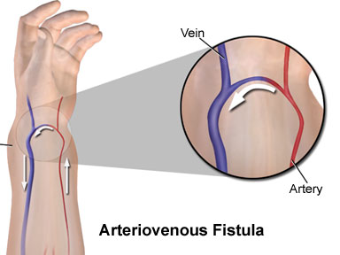
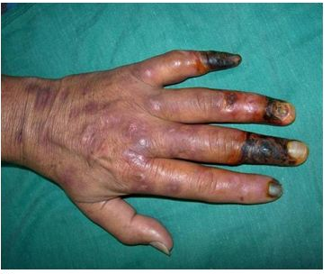
AVF & Steal Syndrome
Images courtesy of icuroom.net & intechopen.com

Slide 39
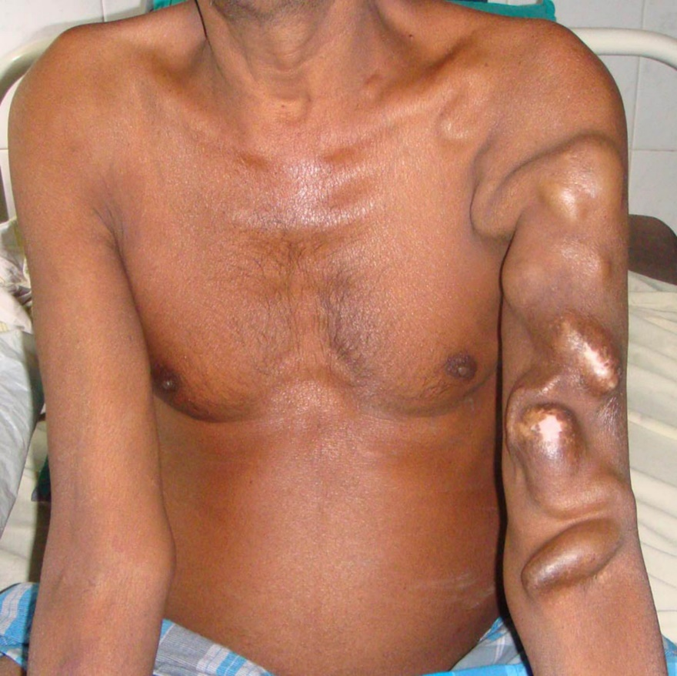
AVF & Heart Failure
Cardiac Output (CO)
5.6 L/min (M)
4.9 L/min (F)
AVF blood flow (QA)
when large, up to 2 - 3.5L/min
Keep QA/CO <0.3 to avoid high output heart failure
15G 16G
Images courtesy of casesjournal.com

Slide 40
Catheter Complications
Non-function: low flow, thrombosis
Infections: catheter lumen/bacteremia, tunnel, exit site
Central venous stenosis/thrombosis
Avoid puncture of cephalic, basilic veins to preserve for future AV access

Slide 41
Catheter Infections
Tunnel*
Exit site
Lumen/systemic*
*usually requires catheter removal

Slide 42
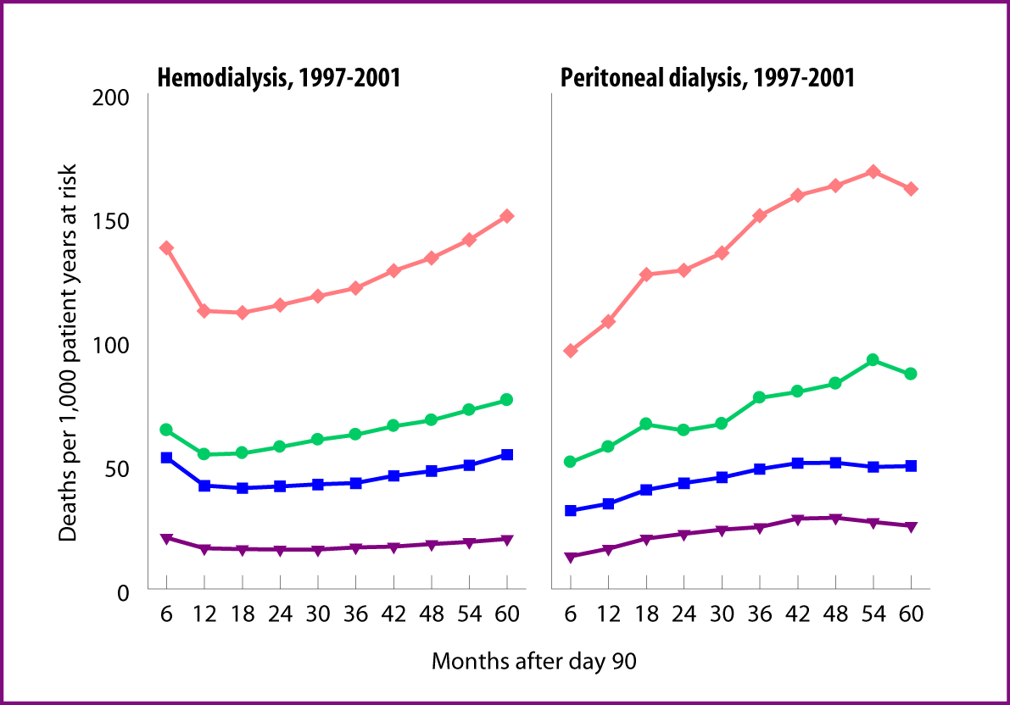
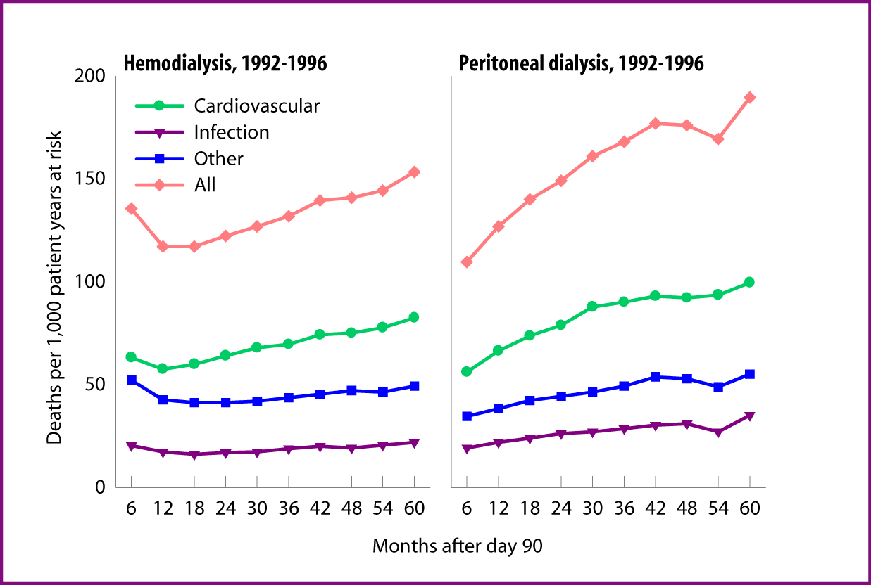
Causes of Mortality in Dialysis
U.S.Renal Data Systems: USRDS Annual Data Report 2005
Notes:
* Incident dialysis patients; rates adjusted for age, gender, race, & primary diagnosis. ESRD patients, 1996, used as reference cohort.

Slide 43
Central Venous Stenosis
Most commonly from cannulation of subclavian veins
Right IJ catheters preferred over left IJ
Transvenous placement pacemaker/AICD, PICC lines can also result in central vein stenosis
AV access options lost on side with stenosis

Slide 44
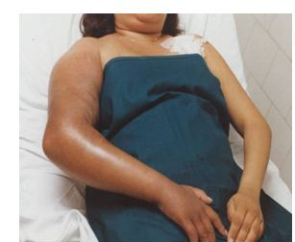
Central Venous Stenosis

Slide 45
Indications for Acute Dialysis
Acidosis - metabolic, typically for pH <7.15
Electrolyte abn* - hyperK⁺, hyperCa⁺⁺
Intoxications
Overload of fluid*
Uremia - encephalopathy, pericarditis
*refractory to medical therapy

Slide 46
Dialysis for Intoxications
Best for small molecules (<500 Da), low protein-binding, mostly intravascular
Alcohols: Methanol, ethylene glycol, isopropanol, ethanol, acetone
Meds: salicylates, theophylline, lithium, atenolol, sotalol, procainamide, barbiturate
Peritoneal dialysis has poor clearance

Slide 47
Indications for Chronic Dialysis
Absolute:
Encephalopathy, Pericarditis, Pleuritis
Relative:
Refractory acidosis, electrolyte abnormalities
Unmanageable fluid overload
Decrease nutrition; weight loss, low albumin, nausea & vomiting, diarrhea
Cognitive decline
eGFR <5 ml/min/1.73m²

Slide 48
Key Points
Principles of dialysis: diffusion, convection
Complications related to principles of dialysis and to dialysis access
AVF > AVG > CVC
Indications for acute dialysis: “AEIOU”
Indications for chronic dialysis: absolutely encephalopathy, pericarditis, pleuritis

Slide 49


Questions ?
@workingkidney

